Slide 1
Microsoft Entra ID Governance
Assign Employee access to resources
Proof of concept deployment

Slide 2




















Contoso’s user journey
Life Cycle Automation
Just-in-time access, alerts, and approval workflows to protect access to critical resources
Self-Service access request when additional access is needed
Onboard the user into the directory when the user joins or start working with Contoso
Teams sites
SharePoint Libraries
Automate the granting of access rights to resources
Make sure access rights are removed when user leaves or stops working with Contoso
SaaS apps
Access recertification
to reduce risk
On-premises apps
Ongoing auditing & reporting

Slide 3



Access requests, workflow and approvals Entitlement management
User
onboarded
Give users self-service access requests for resources and automate approval workflows and access assignment, reviews, and expiration for all human identity types (users, guests, etc.)
Self-service policy and workflow can be defined by app, group or site owners
Supports multi-stage approval workflows, separation of duties enforcement, and recurring access recertification
Supports custom workflows for access lifecycle (through Logic Apps integration)
Access time-limited, guests removed when last access expires
Job
changes
Request
(additional)
access
Ongoing auditing & reporting
Review and revise
Provision
access

Slide 4






Request and provisioning workflow integrations Custom workflows for access lifecycle
Public preview
Access packages and policies
Azure Logic Apps
Additional integrations
Custom approval workflows Finer-grained per-app role provisioning Ticketed provisioning for disconnected apps Custom notifications
When access requested
When access approved
Access granted actions
Access removed actions
Business apps
No/low-code workflow
ITSM
SCIM, LDAP, SQL, and more
Notes:
New video series, creating and using Entitlement Management Custom Extensions for Access Packages https://www.youtube.com/watch?v=tl1GZ_JGMBk

Slide 5
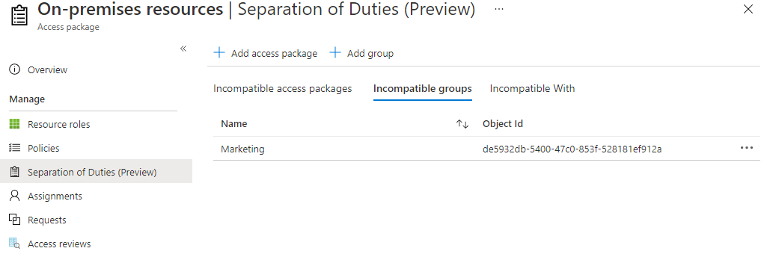
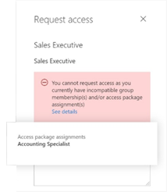
Separation of Duties
Restrict users from requesting an access package
if they already have an assignment to another access package, or
if they are a member of a group
Report on users who have incompatible access rights
Alert on users receiving access directly to applications
Notes:
In each of an access package's policies, you can specify who is able to request that access package, such as all member users in your organization, or only users who are already a member of a particular group. However, you may wish to further restrict access, in order to avoid a user from obtaining excessive access. With the separation of duties settings on an access package, you can configure that a user cannot request an access package, if they already have an assignment to another access package or are a member of a group.
For example, you have an access package, Marketing Campaign, that people across your organization and other organizations can request access to, to work with your organization's marketing department on that marketing campaign. Since employees in the marketing department should already have access to that marketing campaign material, you wouldn't want employees in the marketing department to request access to that access package. Or, you may already have a dynamic group, Marketing department employees, with all of the marketing employees in it. You could indicate that the access package is incompatible with the membership of that dynamic group. Then, if a marketing department employee is looking for an access package to request, they couldn't request access to the Marketing campaign access package.

Slide 6
Auto assignment Rules

Slide 7
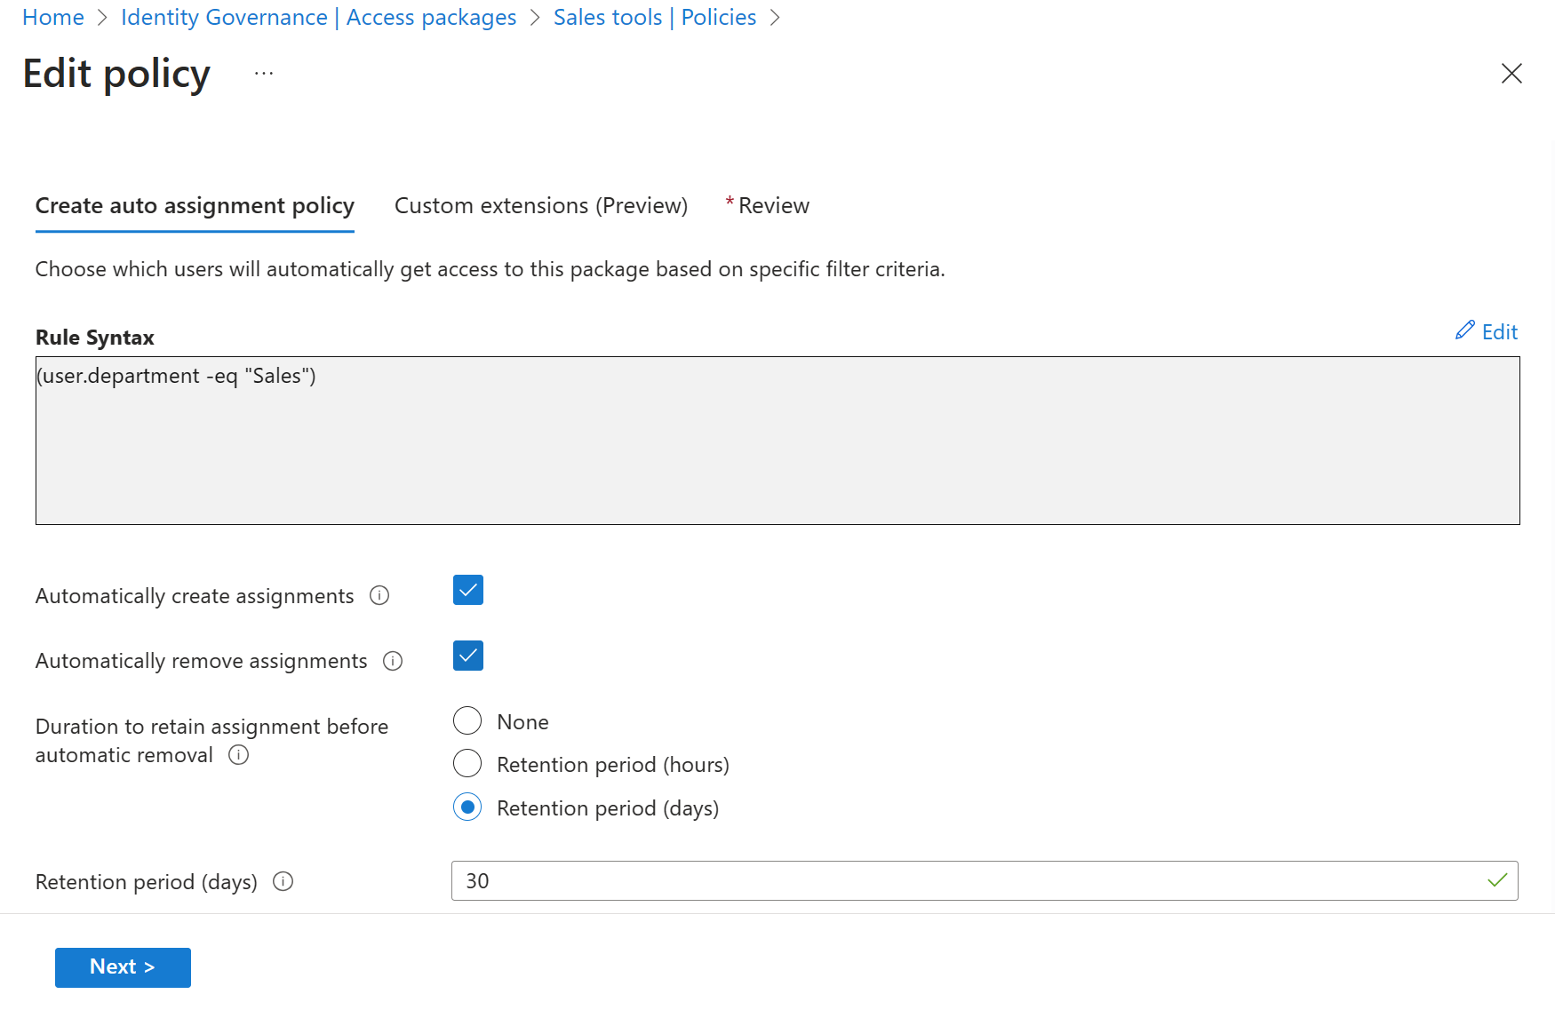
Assign and remove resources automatically Birthright assignment
Use rules to determine access package assignment based on user properties, similar to dynamic groups.
Assignments to users are added or removed depending on whether they meet the rule criteria.

Slide 8
Features
Automatically create assignments: Add the user when an user properties matches with the policy's membership rule
Automatically remove assignments : Remove the user when an user properties matches with the policy's membership rule

Slide 9
Planning- Decisions to consider
-Access Package name and description
-Define if this Access Package will have approval stages. If it does, define approvers and requestors.
-Attribute(s) for the Business rule definición
-Automatically create assignment
-Automatically remove assignment

Slide 10
Deploy
Step | Instructions
Create an Access Package | Create an access package in entitlement management
Create auto assignment policy | Create an automatic assignment policy
Detailed Step by step
Configure an automatic assignment policy for an access package in entitlement management - Microsoft Entra | Microsoft Learn

Slide 11
Custom Workflows with Logic Apps

Slide 12
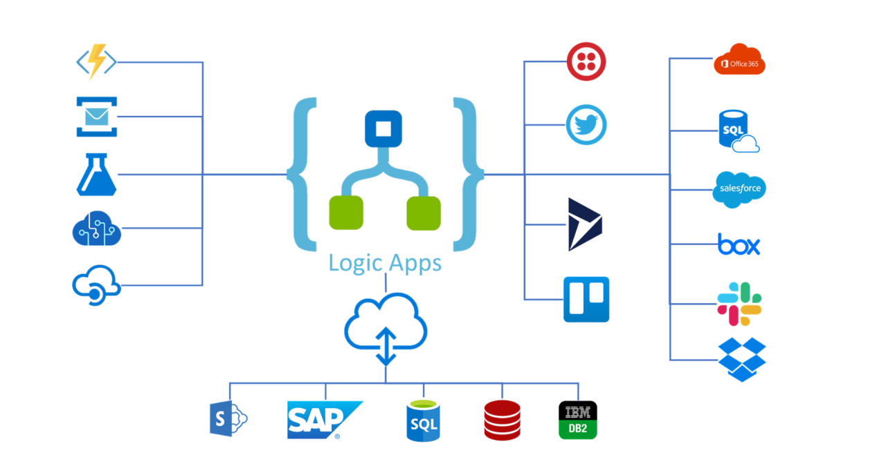
What is a Logic App?
Azure Logic Apps is a cloud platform where you can create and run automated workflows with little to no code. By using the visual designer and selecting from prebuilt operations, you can quickly build a workflow that integrates and manages your apps, data, services, and systems.

Slide 13
Logic App Integration with Entitlement Management
Used to automate custom workflows and connect apps and services in one place. Users can integrate Logic Apps with entitlement management to broaden their governance workflows beyond the core entitlement management use cases.
When an access package request is created
When an access package request is approved
When an access package assignment is granted
When an access package assignment is removed
14 days before an access package assignment auto expires
One day before an access package assignment auto expires

Slide 14
Use cases examples
Send custom email Notifications
Send Teams notification
Get user information from other applications
Writeback user information to external systems
Call an External web api to trigger actions on external systems
Creating a set of tasks in Microsoft planner
Generate a TAP

Slide 15
Planning- Decisions to consider
Processes that you need to automate during the different request stages
Interfaces available on Target systems
Request stage where you want to trigger the logic app
Have Azure Subscription Resources available
Logic App authentication with target systems

Slide 16
Deploy
Step | Instructions
1. Add custom Extension to a Catalog | Create and add a Logic App workflow to a catalog for use in entitlement management
2. Edit the Custom Extension | Edit a linked Logic App's workflow definition
3. Add custom Extension to an Access Package | Add custom extension to a policy in an access package
Detailed Step by step
Trigger Logic Apps with custom extensions in entitlement management - Microsoft Entra | Microsoft Learn

Slide 17



Scenario: Access Recertification
Joiner / Mover / Leaver
Microsoft Entra ID P2
Access Reviews - Basic access certifications and reviews
Microsoft Entra ID Governance:
Access Reviews targeting inactive identities
Certify PIM for Groups memberships
Machine Learning assisted recommendations
Access Lifecycle Management
Access Recertification
Identity
Secure privileged access for administration

Slide 18

Access recertification to reduce risk Access Reviews
Natively built-in to Microsoft Entra
Manage risk and meet compliance for users, guests and workload identities
Ensure access to sensitive Teams, Groups, Apps, Roles is reviewed periodically

Slide 19
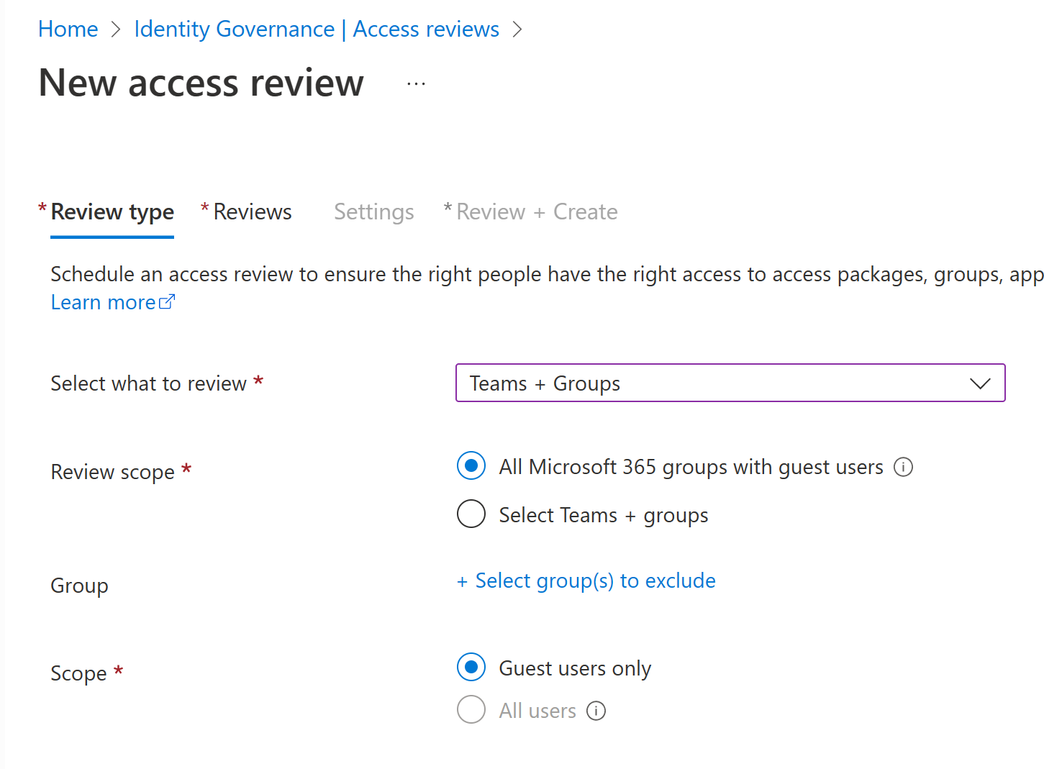
How Access Reviews works Administrator
1. Selects resource
2. Selects scope
Team/Group
SaaS application
Privileged role
Access Package
Guests
Employees
Everyone
Workload Identities
3. Selects reviewer
4. Selects frequency
Team/Group owner
Manager
Specific user(s)
Users’ self review
Weekly
Monthly
Quarterly
Yearly

Slide 20
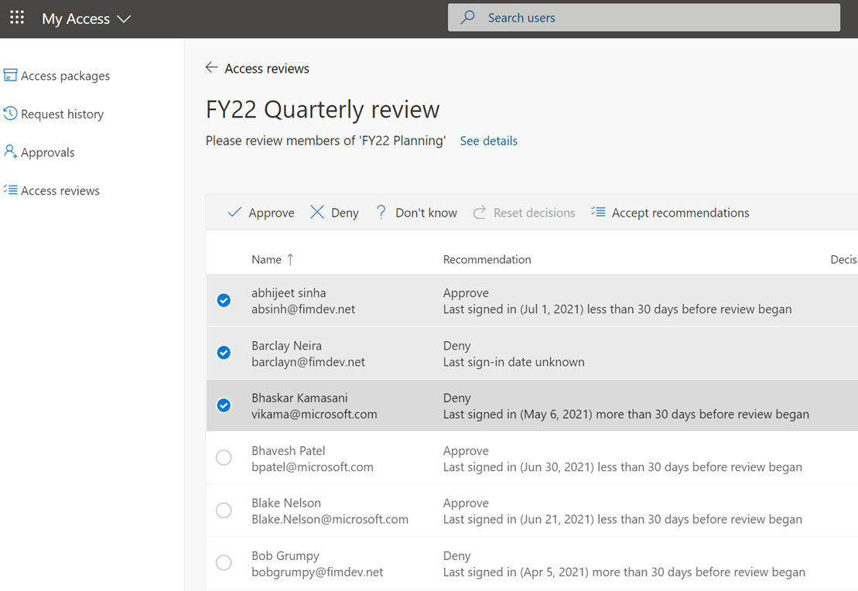
How Access Reviews works Reviewer
1. Send notification
2. Review
Email is sent to the reviewer
Review current membership with system generated recommendations
3. Confirm
4. Apply result
Reviewers confirm which memberships to keep
Denied users are removed from the resource

Slide 21


Access Reviews Scenarios
Employees | External Users
Change jobs or leave the company Employee's previous access are not removed. Users accumulate excessive permissions | Guests invited into the tenant What access should they have? When should they leave?
B2B
Notes:
Employees:
Forget to remove employee's previous access rights.
Users accumulate excessive permissions, increasing risk and the likelihood of audit findings.
Make sure you exclusion groups in CA are always reviewed: https://docs.microsoft.com/en-us/azure/active-directory/governance/conditional-access-exclusion

Slide 22
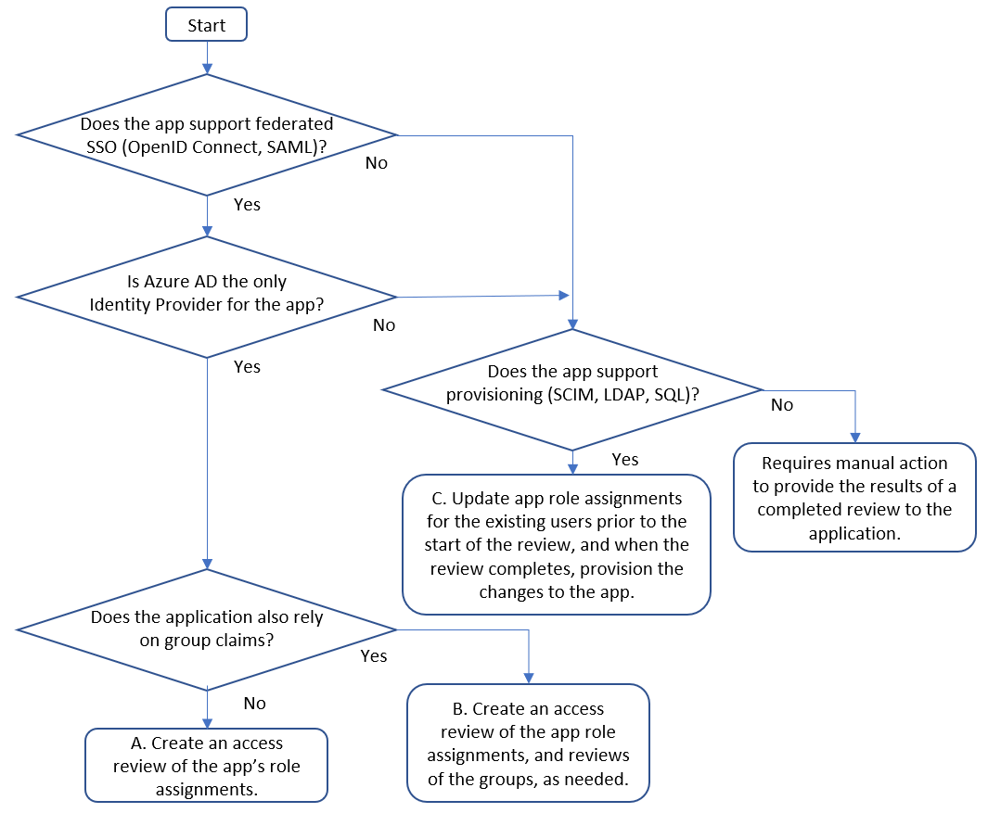
Planning
Determine application readiness

Slide 23
Planning- Decisions to consider
1. Who is responsible for the review?
A. Users review their own privilege​
Schedule access review to ask users themselves if they still need access.
Remove privilege if the user denies or does not respond.​
​B. Resource owners review privileges assigned to their resources.​
Schedule access review to ask resource owners to review the privileges assigned to their resource.
Possible Reviewers:
Group Owners
Specific Users
Managers of Users

Slide 24
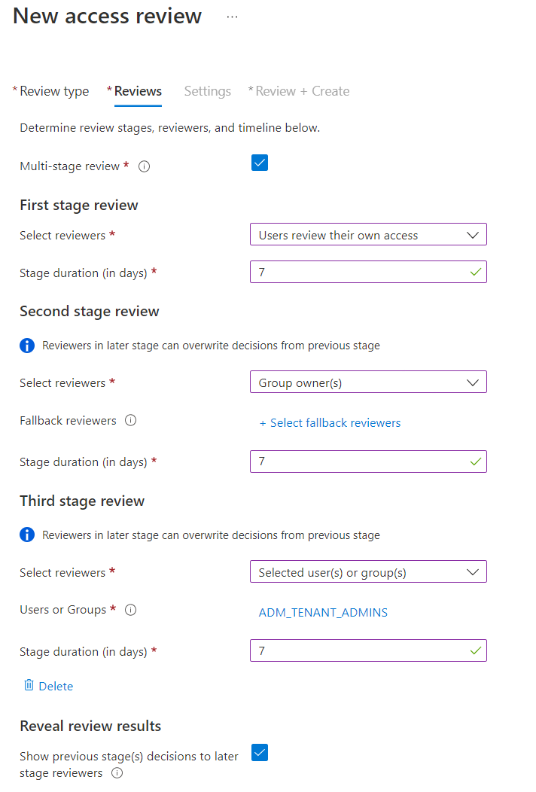
Planning (Contd)
2. How many stages of reviews are needed?
Reach consensus across multiple sets of reviewers
Assign alternate reviewers to weigh in on unreviewed decisions
Reduce burden on later stage reviewers

Slide 25
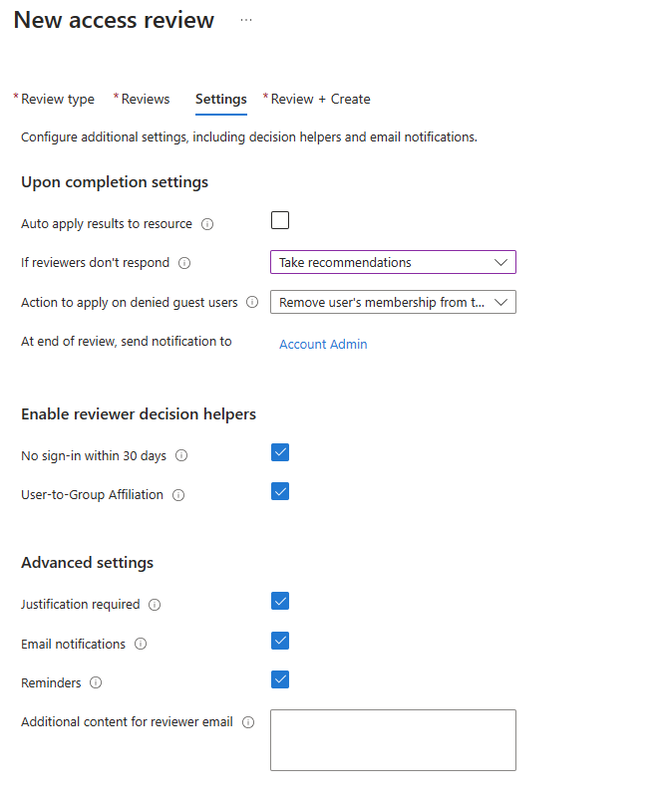
Planning (Contd)
3. Decide on criteria for automated decisions
Response Triggers
Account Inactivity
Justification requirements
Alerting and notifications

Slide 26
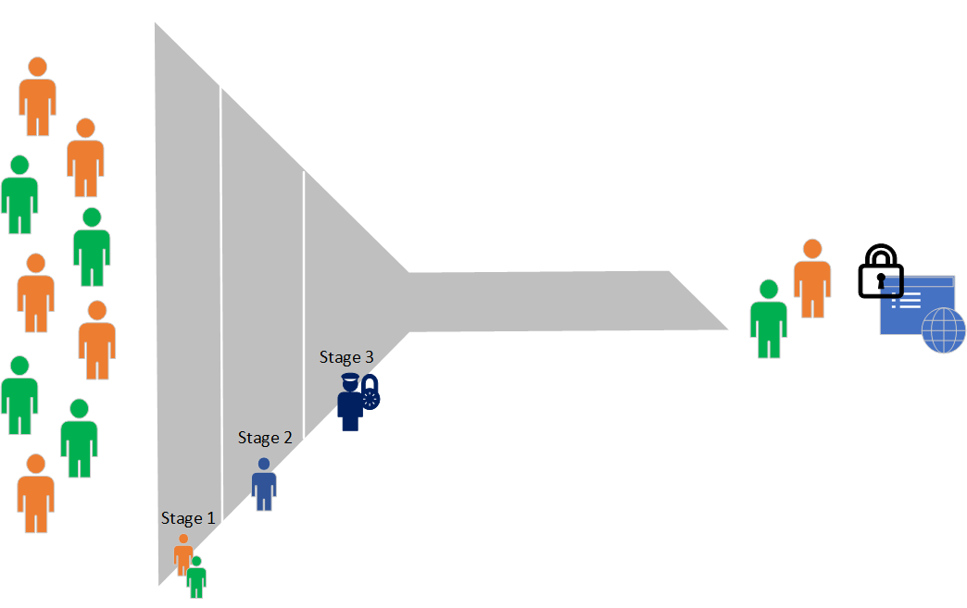
Multi-Stage Reviews Decisions
First stage reviewers?
Select user(s) or group(s) – the owner(s) of the applications
Second stage reviewers?
Managers of users
Show previous stage(s) decisions to later stage reviewers?
Which reviewees go to the next stage?
Expected action on non-response?
Approve/Deny

Slide 27
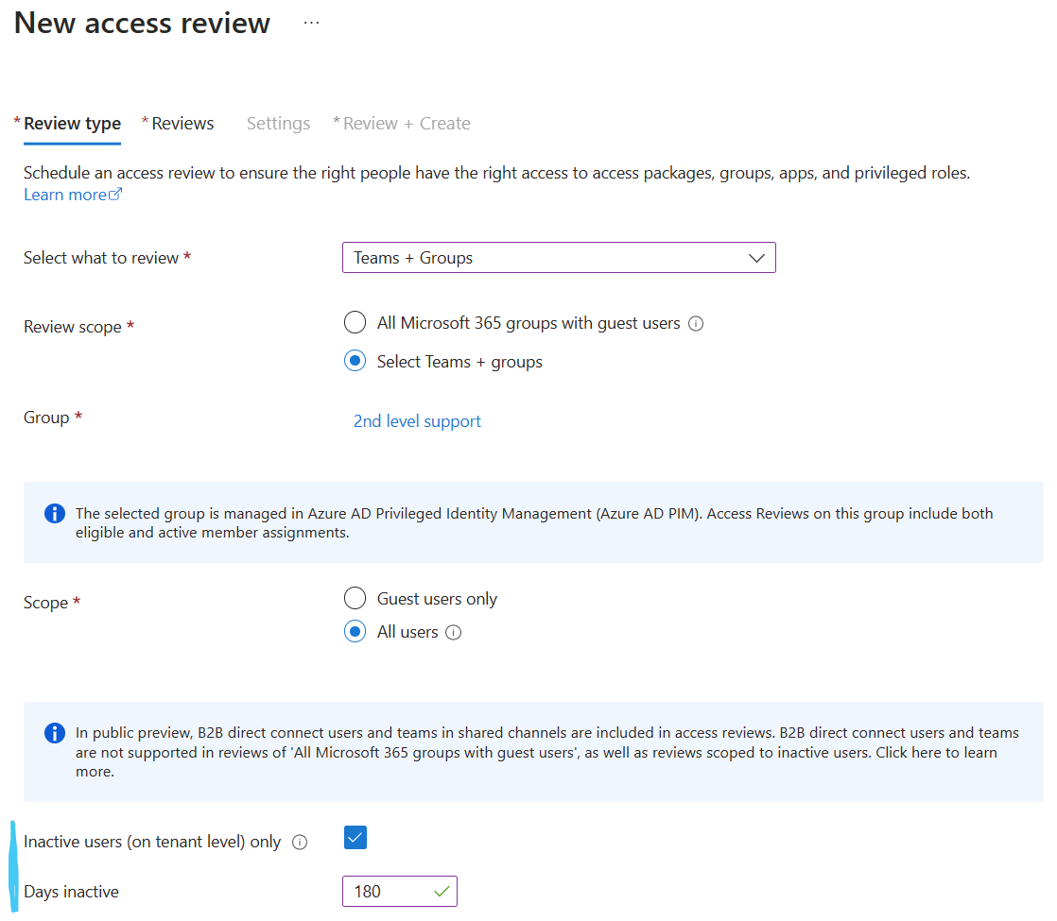
AR – Inactive Users General Availability
Review inactive users
Review and address stale accounts that haven’t been active for a specified period
Includes interactive and non-interactive sign-ins
You define what inactive means
Automatically remove stale accounts
Notes:
Source: Review inactive user accounts

Slide 28




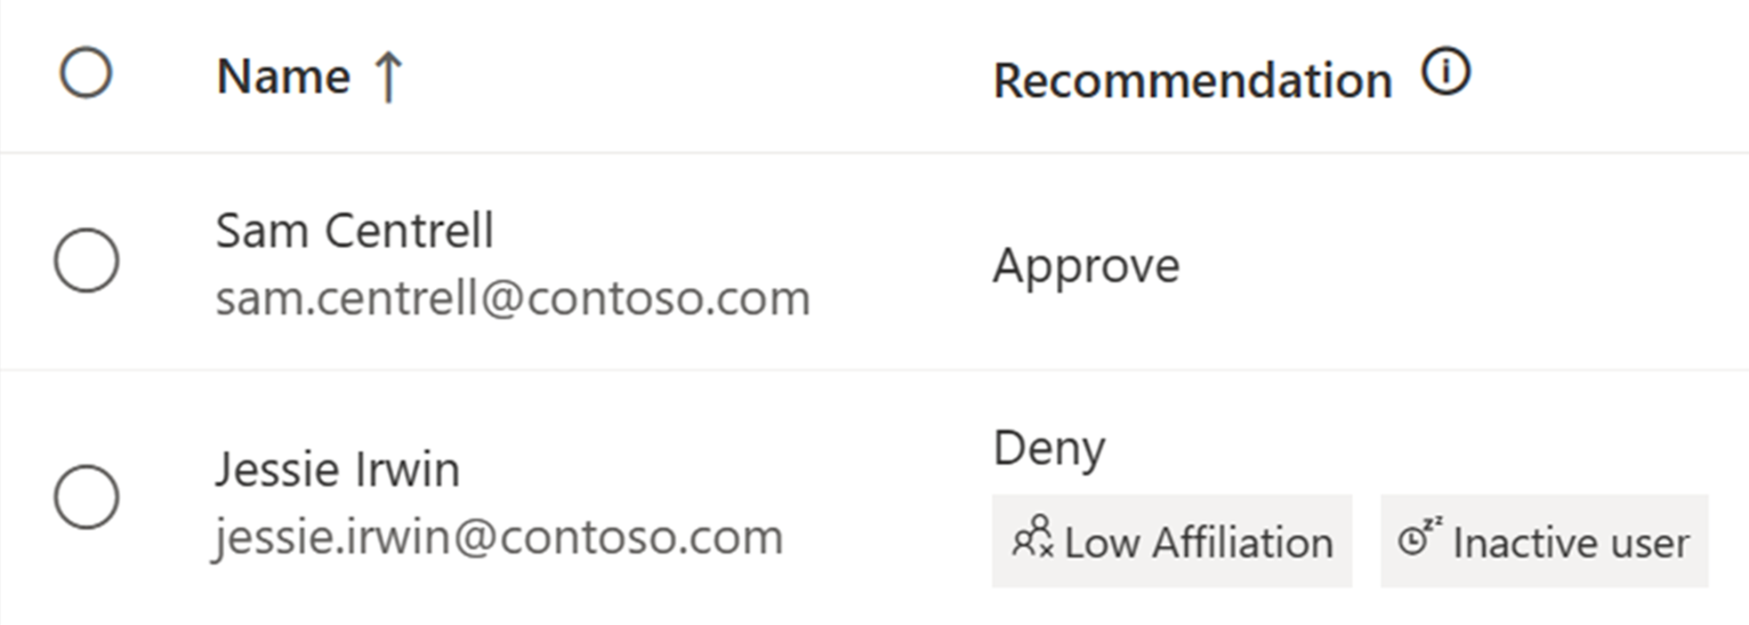



Machine Learning based recommendations in Access Reviews User-to-Group Affiliation
Machine Learning uses organizational distance to calculate group affiliation
Reviewers get data driven recommendations based on last sign in date and group affiliation
Admins create Access Review to protect against breaches and stay compliant
Last sign in activity
Sam Centrell
18 days
Jessie Irwin
125 days
Inactive user recommendation considers activity based on last sign in date
Demo: User-to-Group Affiliation
Notes:
Reviewers see the recommendation if a user has Low Affiliation with other users within the group and helps make quicker decisions based on organizational distance between employees.

Slide 29
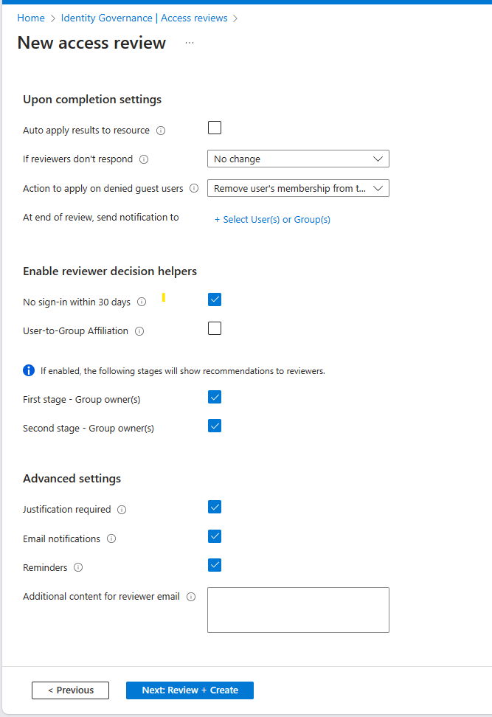
User to Group Affiliation
Detects user affiliation with other users within the group, based on organization's reporting-structure similarity.
Users who are distant from all the other group members based on their organization's chart, are considered to have "low affiliation" within the group.
** Only available for users in your directory.
** A user should have a manager attribute
**Groups with more than 600 users are not supported.
Demo

Slide 30
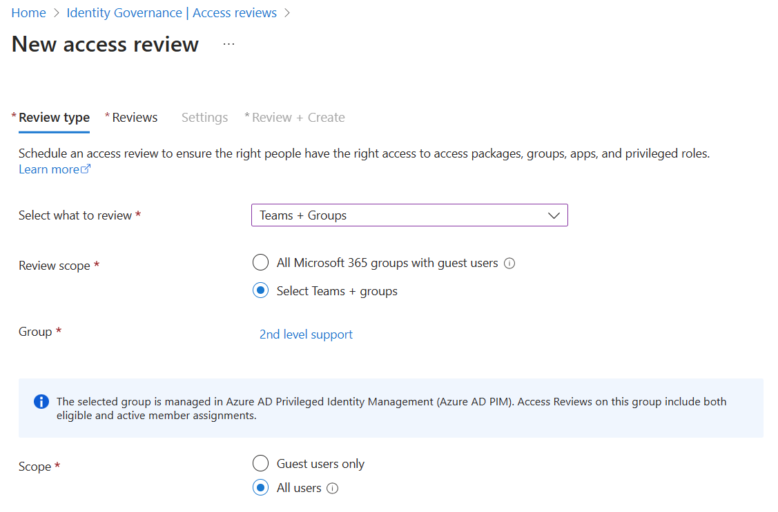
AR – PIM for Groups Public preview
Review access for PIM for Groups
Includes active members of the group and eligible members
Only active owners can be assigned as reviewers
Inactivity of users up to 2 years
Notes:
Source: Review access for PIM for Groups

Slide 31
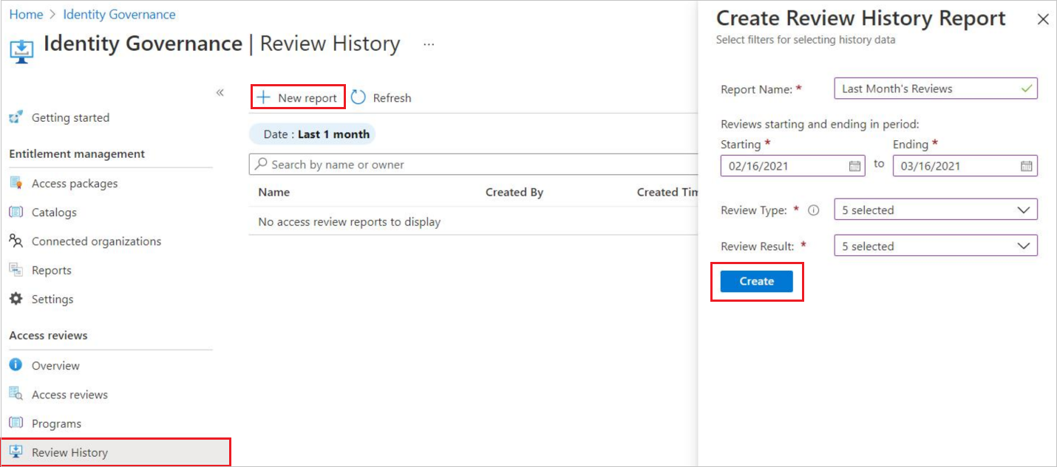
Access Review history report
Downloadable review history to gain more insight on Access Reviews.
Download results for audit and compliance needs, or to integrate with other solutions.
Reports can be constructed to include specific access reviews, for a specific time frame, and can be filtered to include different review types and review result.

Slide 32
Deploying Access Reviews Guide
Scenario | Instructions
Planning an Access Reviews Deployment | Plan a Microsoft Entra access reviews deployment
Access review of PIM for Groups | Create an access review of PIM for Groups (preview)
Access review of Azure resource and Azure AD roles in PIM | Complete an access review of Azure resource and Azure AD roles in PIM
Access review of an access package | Create an access review of an access package in entitlement management

Slide 33
Join Entra ID Governance Advisors - Customer Community
What is Entra ID Governance Advisors
Entra ID Governance Advisors is a community that consists of selected customers and partners who collaborate via virtual small/large group discussions, content reviews, digital forum and more
Benefits of Joining the Entra ID Governance Advisors:
Members benefit by participating in the following ways:
Direct engagement with Microsoft Product Groups
Dedicated sessions focused on upcoming features and deep-dives
Early access to Private Preview and Roadmap access
Valuable inputs from Microsoft and other customers all under NDA
Learn and interact with other customers across verticals, sizes, and segments\
Please fill out the survey here if interested in joining: https://aka.ms/MicrosoftEntraAdvisors/

Slide 34

Next Steps
Give us feedback, let us know your comments: aka.ms/idnacat/igapocsurvey
Are you ready for deployment?

Slide 35

Thank you

